Slide 1

CREDIT RISK, SENTIMENT ANALYSIS & n.P.S. (net Promoter Score)
Tricia
Turning data into meaningful stories with actionable insights
Data Analyst | Python • Power BI • SAS • SQL • Sentiment Analysis • NPS

Slide 2

Agenda
Data Cleansing & Quality Check
Correlation
Voluntary Attrition & Sentiment Analysis
Involuntary Attrition & NPS
ML Model
Summary

Slide 3
Full List of Data Cleansing / Quality Check
1. Initial Inspection
df.head() / df.sample() — View data sample
df.shape — Rows & columns
df.info() — Check column types and nulls
df.describe() — Summary statistics
df.columns — List of column names
2. Structural Integrity
Check for duplicate rows
df = df.drop_duplicates()
Check for duplicate column names
df.columns.duplicated().any()
3. Missing Data
Identify missing values
df.isnull().sum()
Decide how to handle:
Drop rows: df.dropna()
Fill values: df.fillna(method='ffill') or use mean/median
Flag them: create an indicator column
4. Data Types
Ensure correct data types
df.dtypes
Convert as needed
df['date'] = pd.to_datetime(df['date'])
df['category'] = df['category'].astype('category')
5. Outliers and Invalid Values
Visualize with boxplots or histograms
Use z-score or IQR method
Check for impossible values (e.g. negative ages, invalid ZIP codes)
6. Consistency Checks
Standardize text:
df['column'] = df['column'].str.lower().str.strip()
Ensure consistent units (e.g. dollars vs cents, kg vs lb)
Align formats (e.g. phone numbers, SSNs, ICD codes)
7. Unique Identifiers
Confirm that key columns (e.g., ID, claim number) are unique:
df['ID'].is_unique
Check for duplicates:
df[df.duplicated(subset='ID')]
8. Invalid Categories or Values
Use .unique() to inspect:
df['status'].unique()
Cross-check with expected values (e.g. ['active', 'inactive'])
9. Date and Time Consistency
Convert to datetime: pd.to_datetime()
Sort and check sequence/order
Ensure no future dates for things like birth or service dates
10. Numerical Checks
Check for negatives where not allowed (e.g. income, age)
Validate ranges
Handle infinite or NaN values
df = df.replace([np.inf, -np.inf], np.nan)
11. Data Normalization (Optional, ML-focused)
Scaling numeric features (MinMax or StandardScaler)
Encoding categorical variables (Label or OneHot)
12. Column Renaming and Documentation
Clean messy column names
df.columns = df.columns.str.strip().str.lower().str.replace(' ', '_')
Document your data dictionary

Slide 4
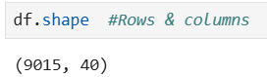
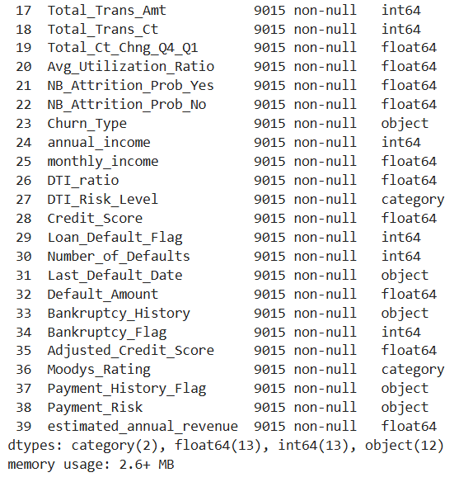
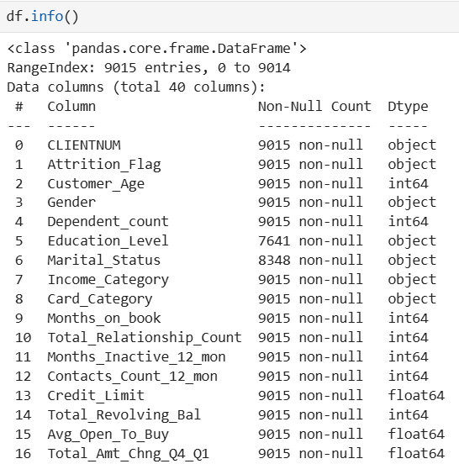
Data Cleansing / Quality Check in Progress (1)

Slide 5
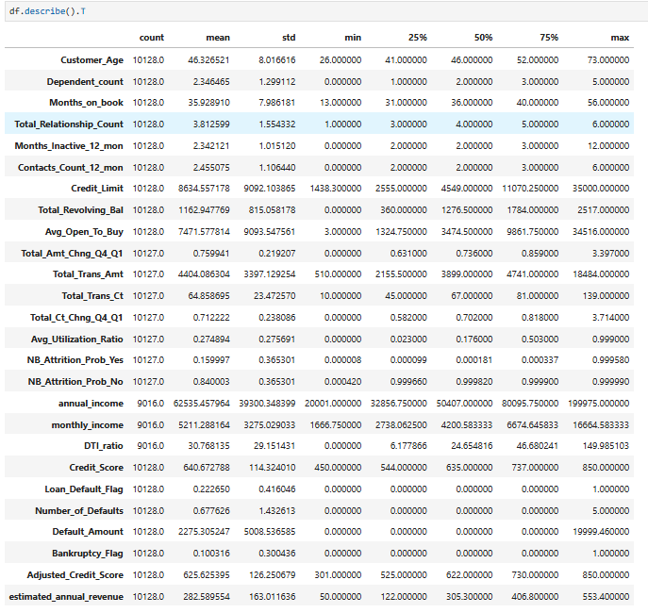
Data Cleansing / Quality Check in Progress (2)

Slide 6
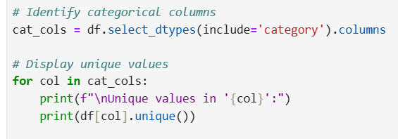
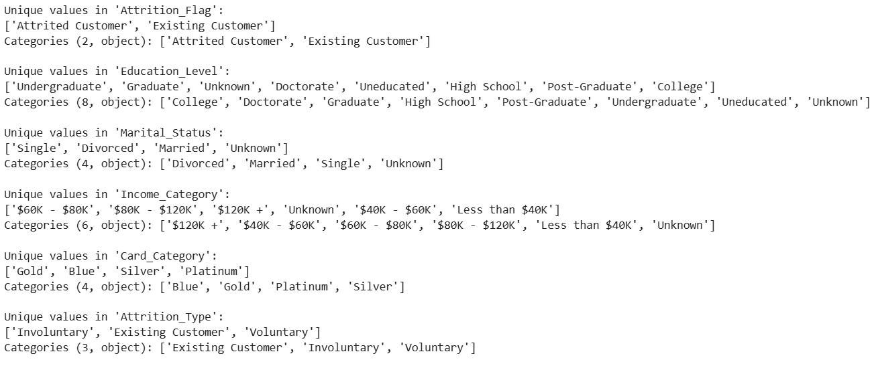
Hidden Missing Value

Slide 7
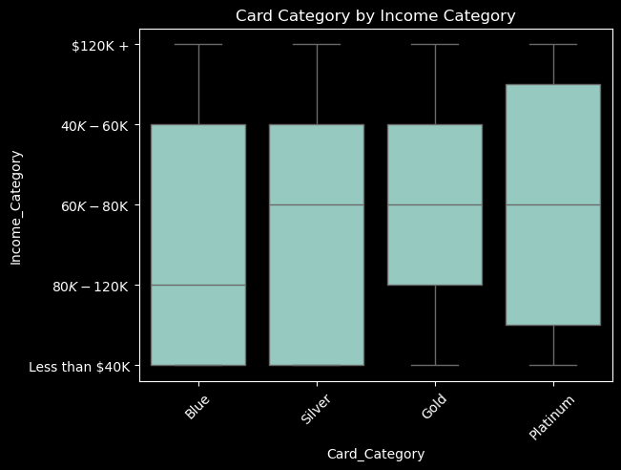
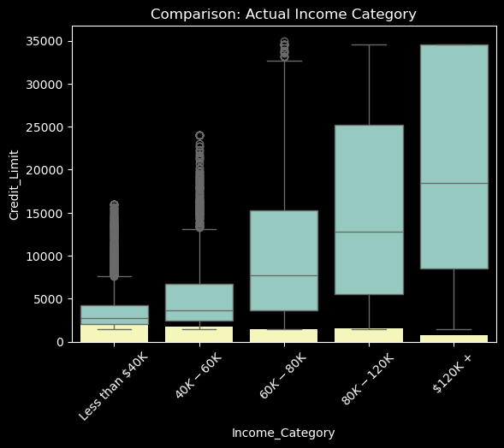
How to fill up missing Income_Category?

Slide 8
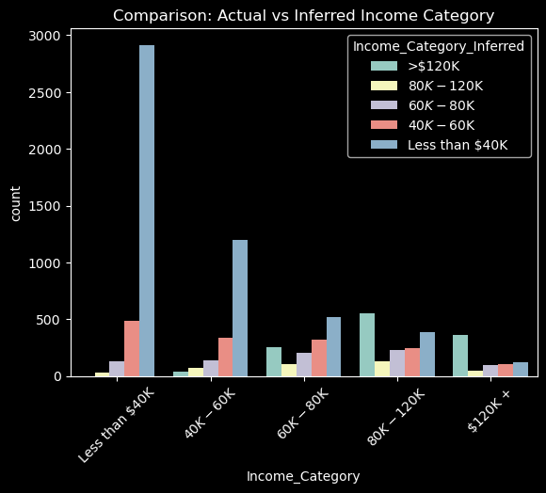
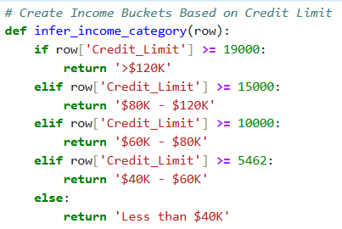
Missing Income_Categoary data is filled up according to Credit_Limit

Slide 9
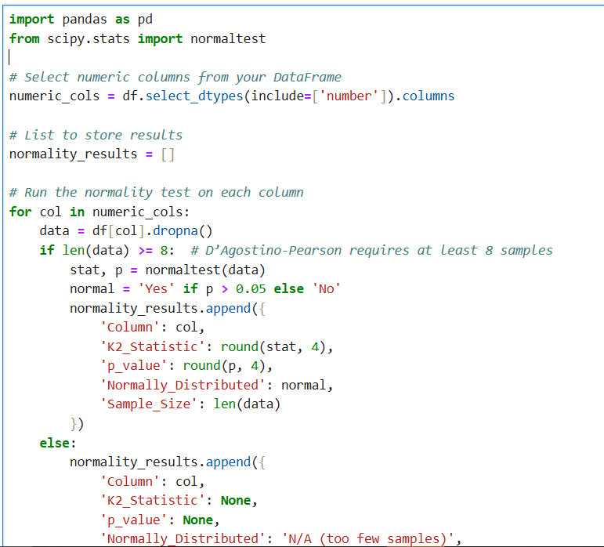
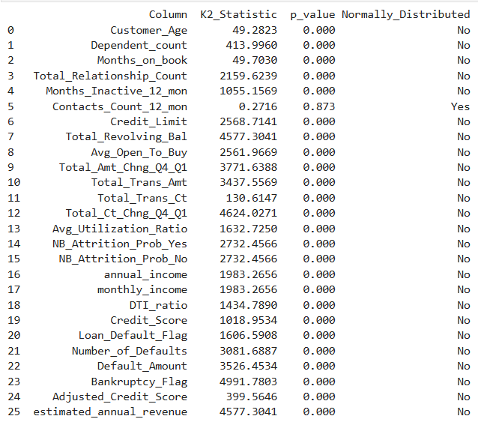
Data Cleansing / Quality Check in Progress (3)
Normality Check for Numerical Variables
All, except one variable, are not normally distributed.

Slide 10
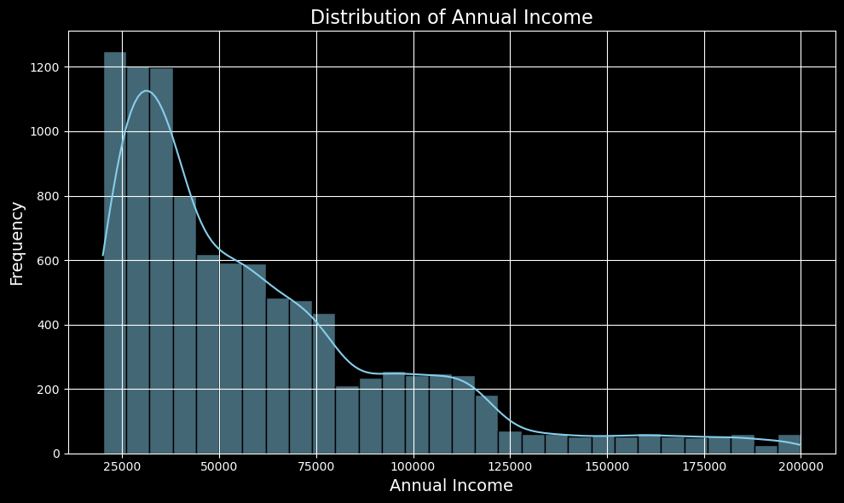
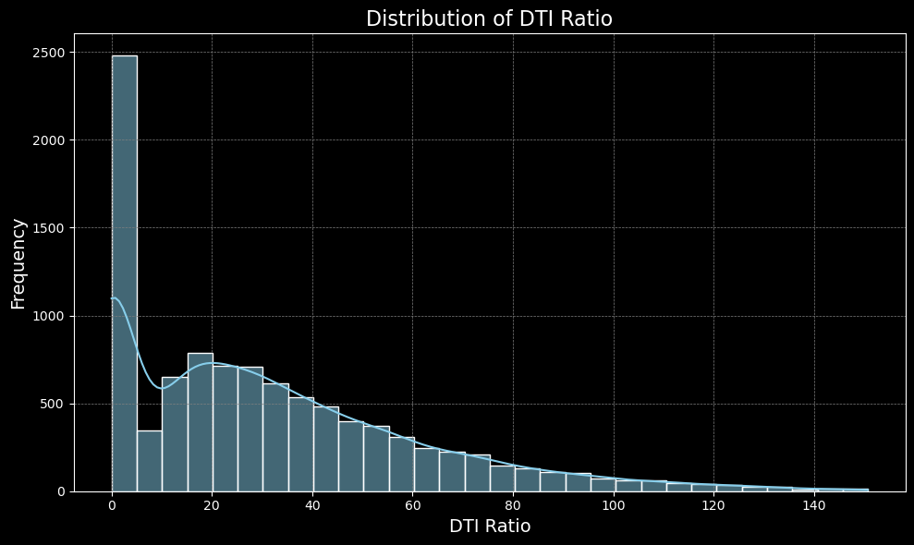
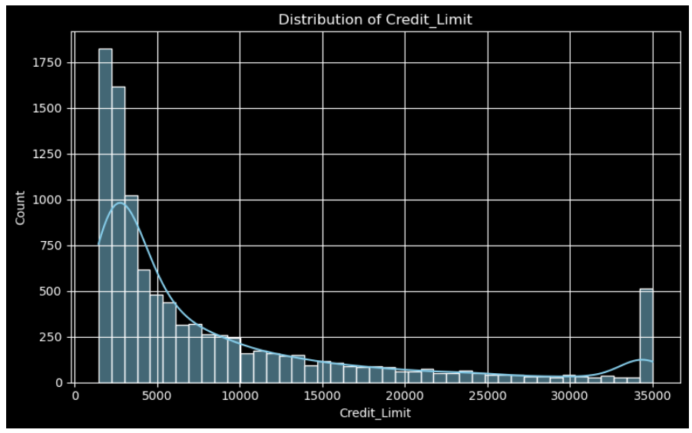
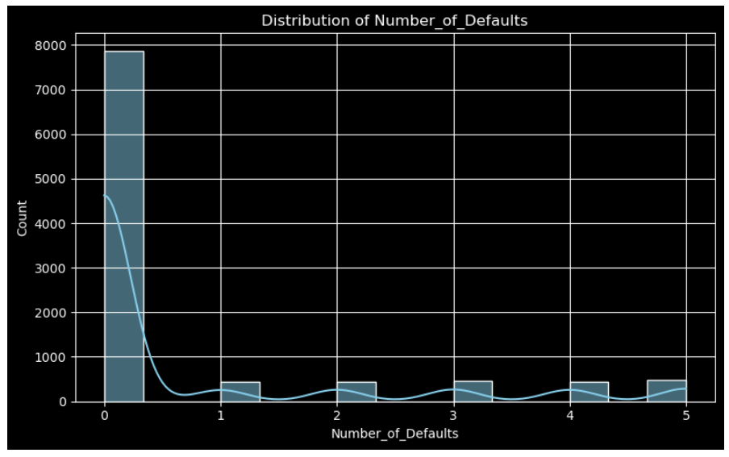
Normality Check – Bar Chart

Slide 11
DEBT-TO-INCOME
DTI Ratio= (Total Monthly Debt Payments / Gross Monthly Income ​)×100
DTI Range | Interpretation
0%–20% | Excellent
21%–36% | Good
37%–49% | Risky
50%+ | High Risk

Slide 12
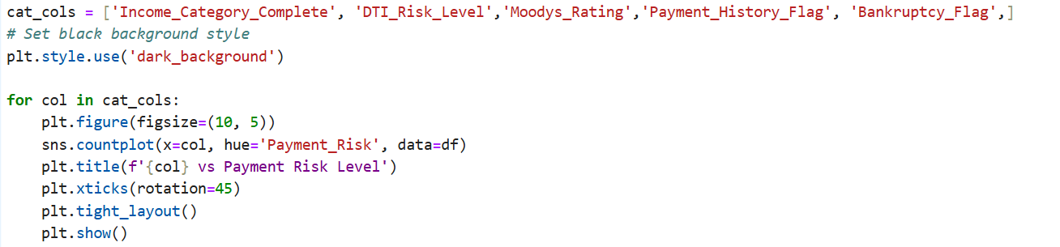
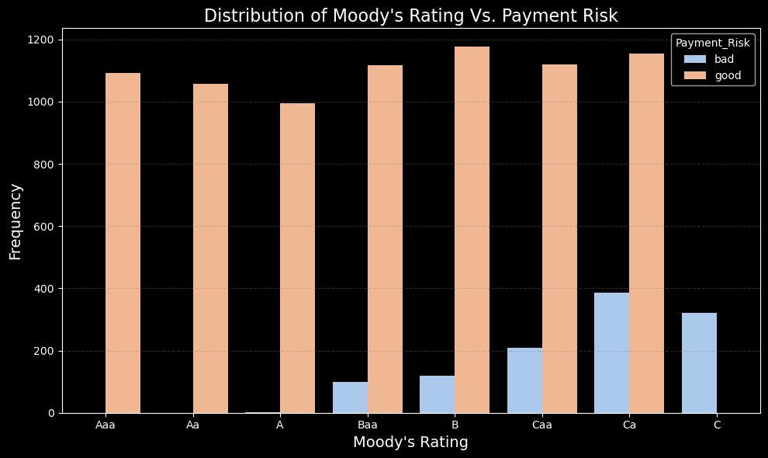
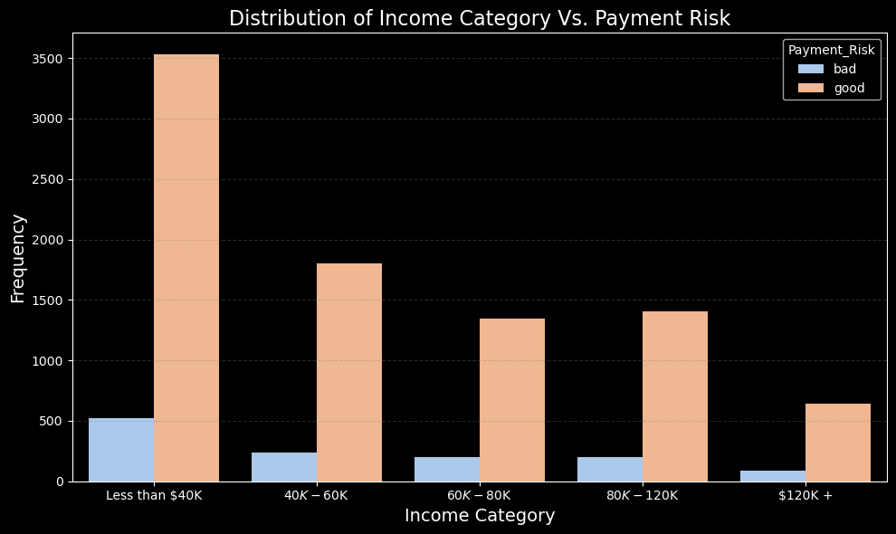
Categorical Data Insights (1)

Slide 13
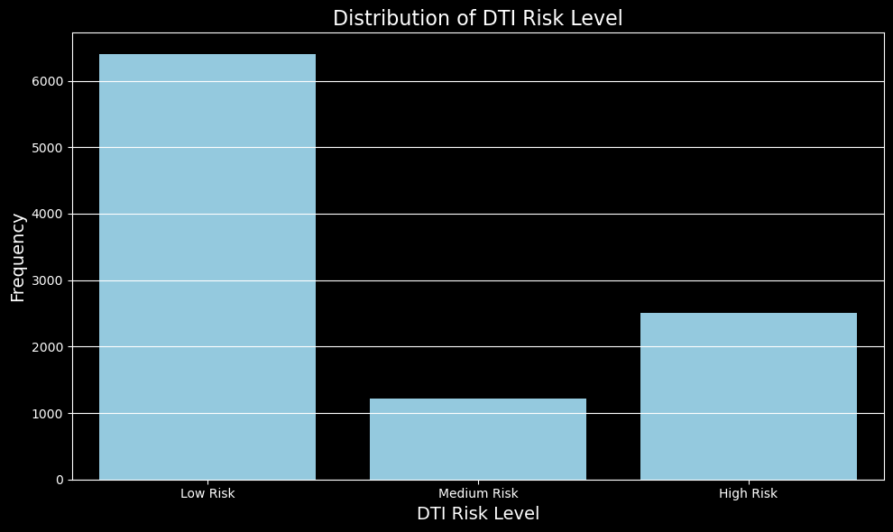
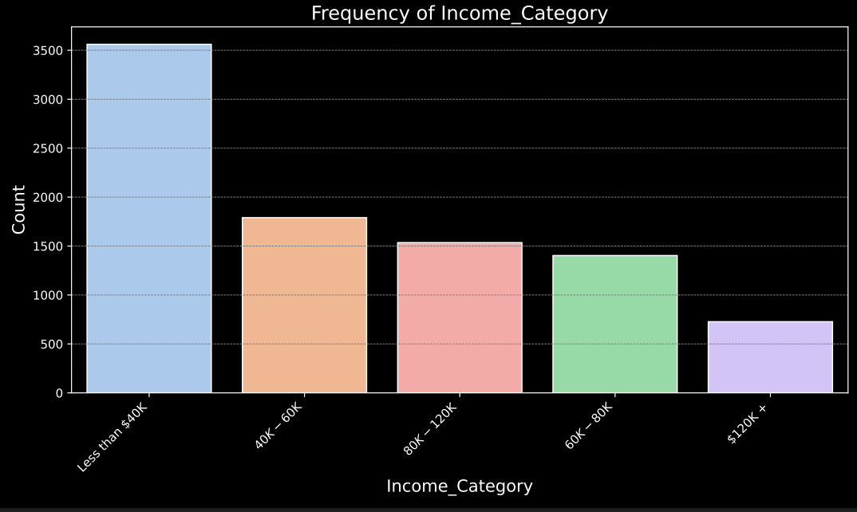
Categorical Data Insights (2)

Slide 14
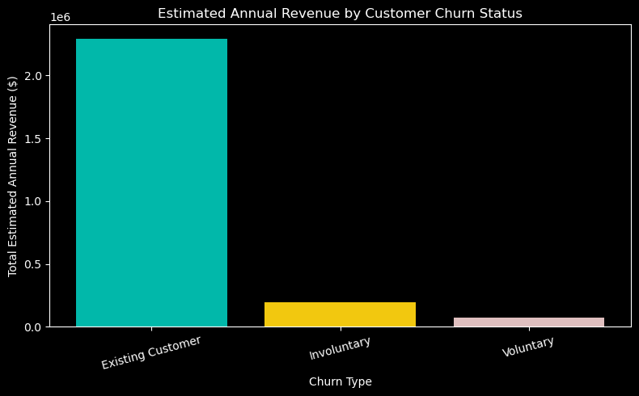
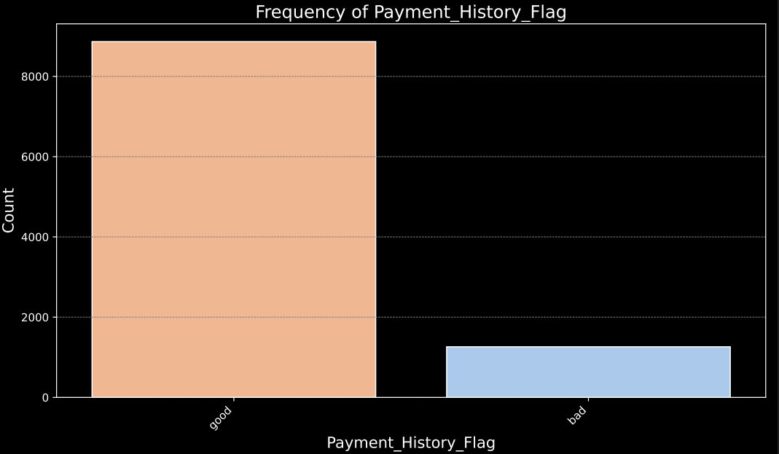
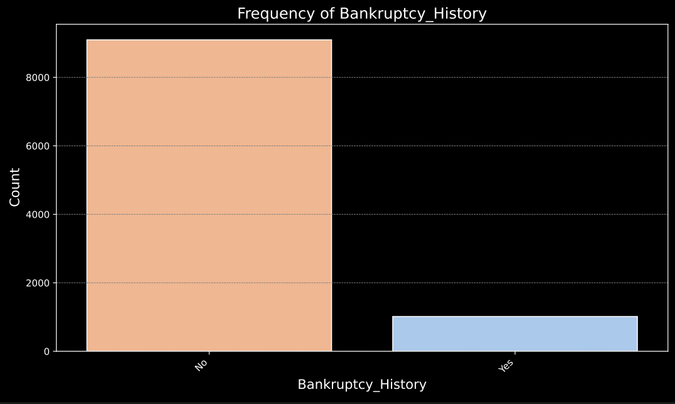
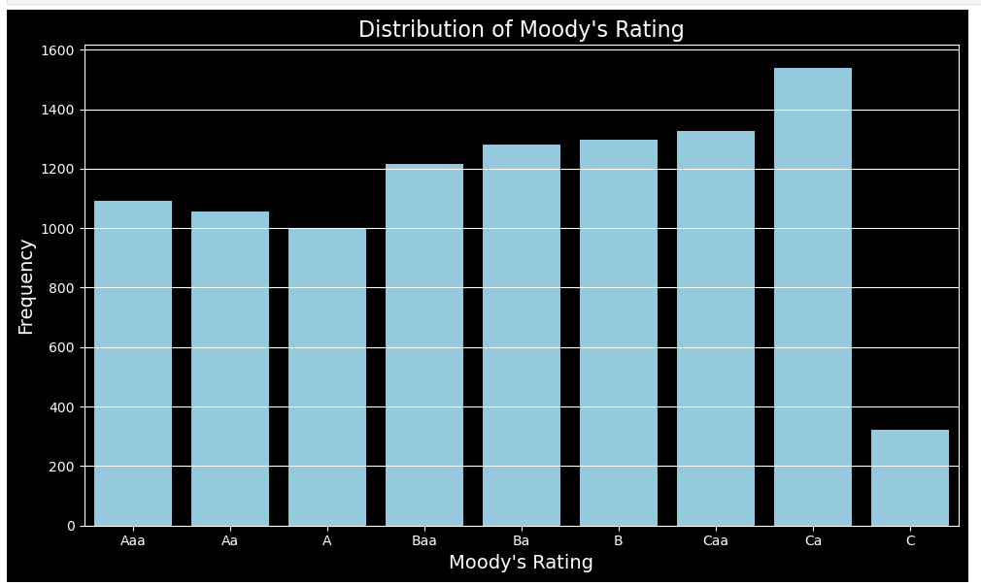
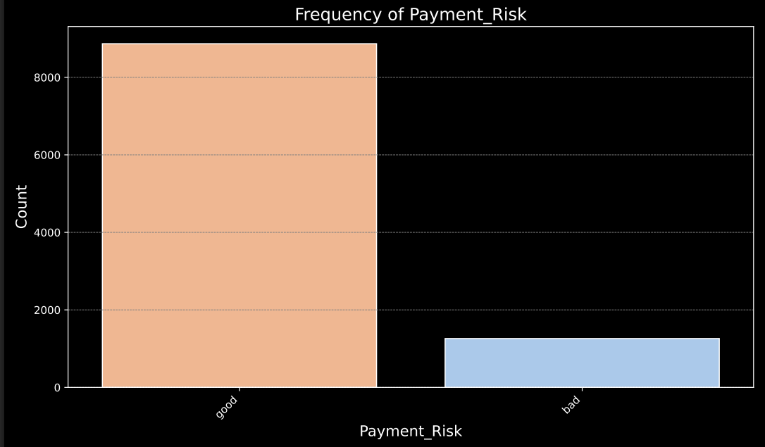
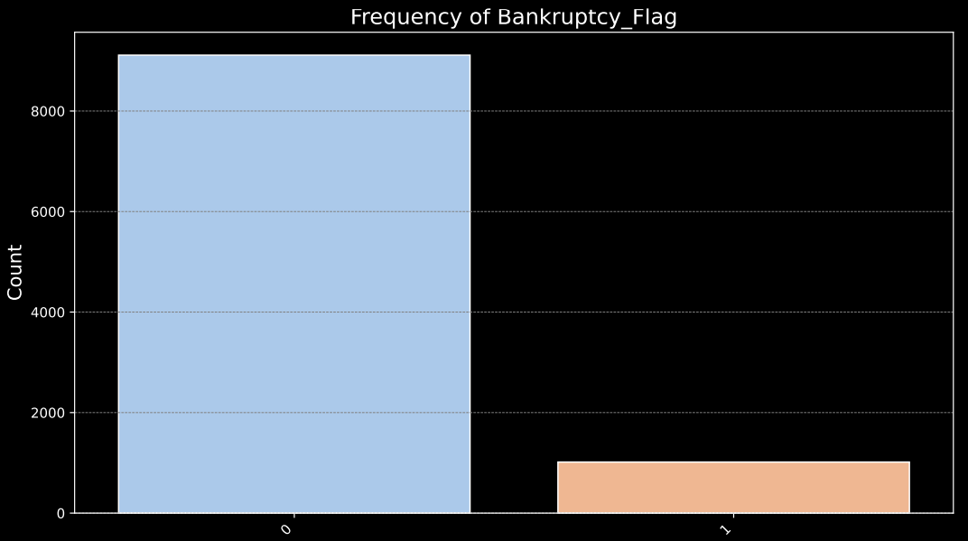
Categorical Data Insights (3)

Slide 15
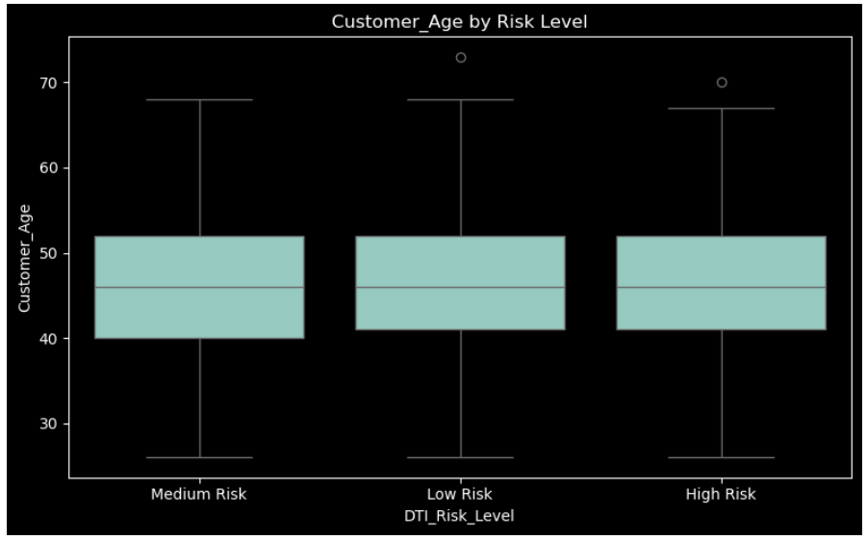
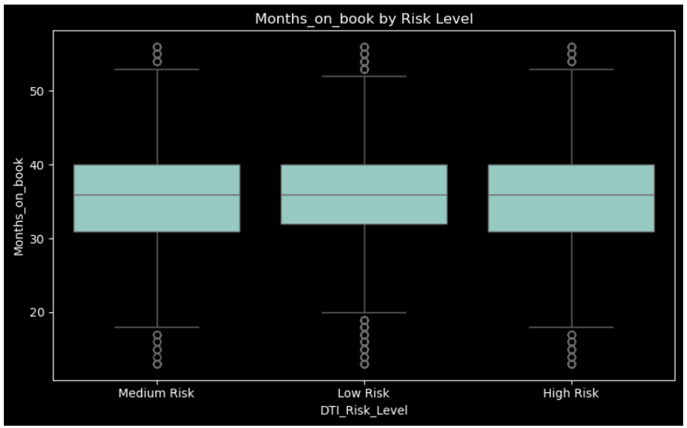
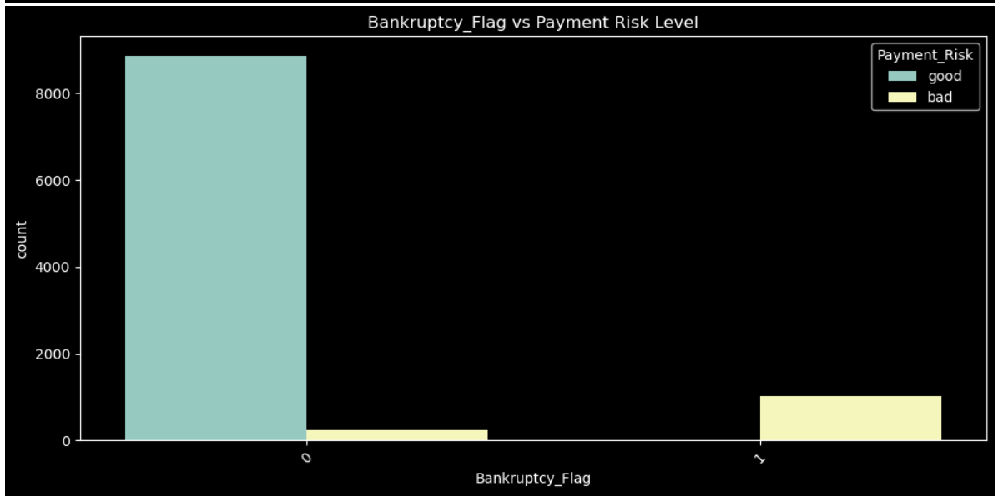
Categorical Data Insights (4)

Slide 16
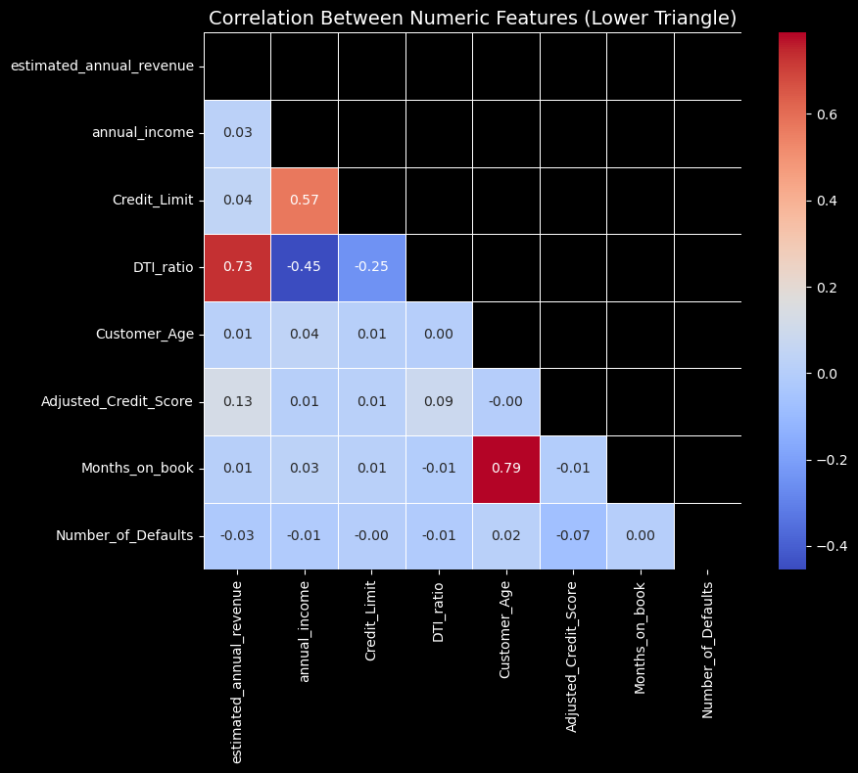
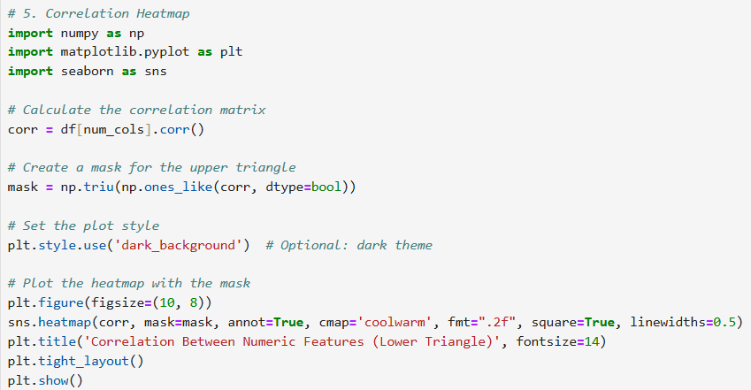
Correlation Heatmap

Slide 17
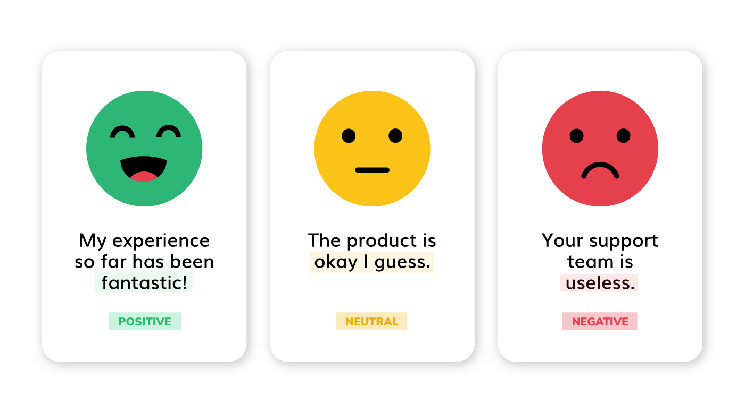
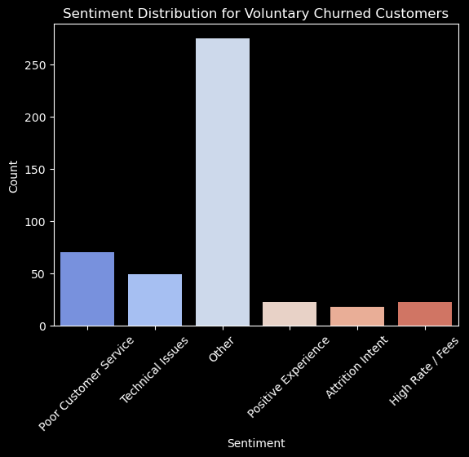
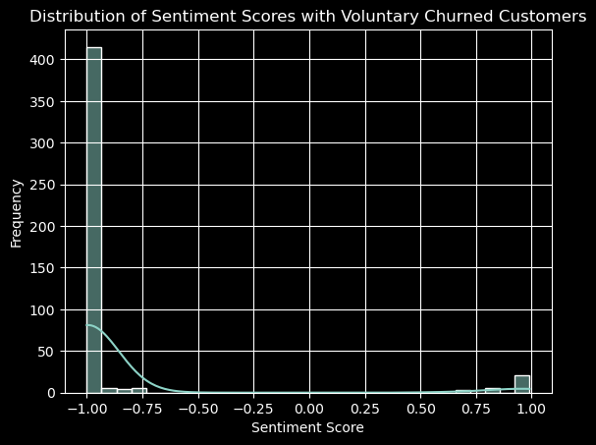
Voluntary Churn
Sentiment Analysis – know why to help us grow

Slide 18
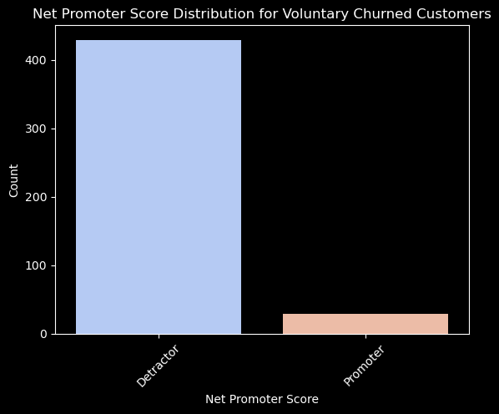
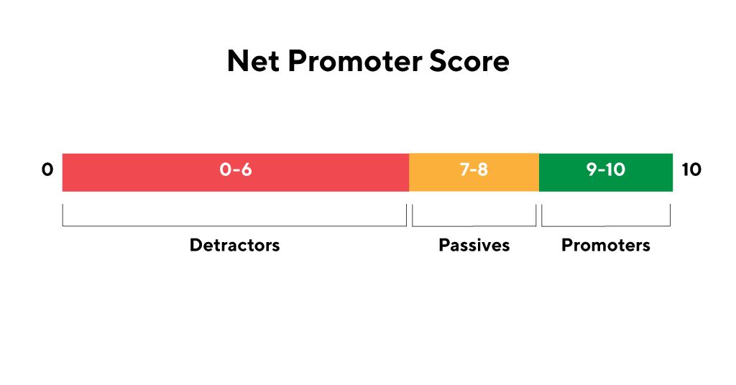
Voluntary Churn
NPS Analysis
(Net Promoter Score)
- Help us know our future

Slide 19
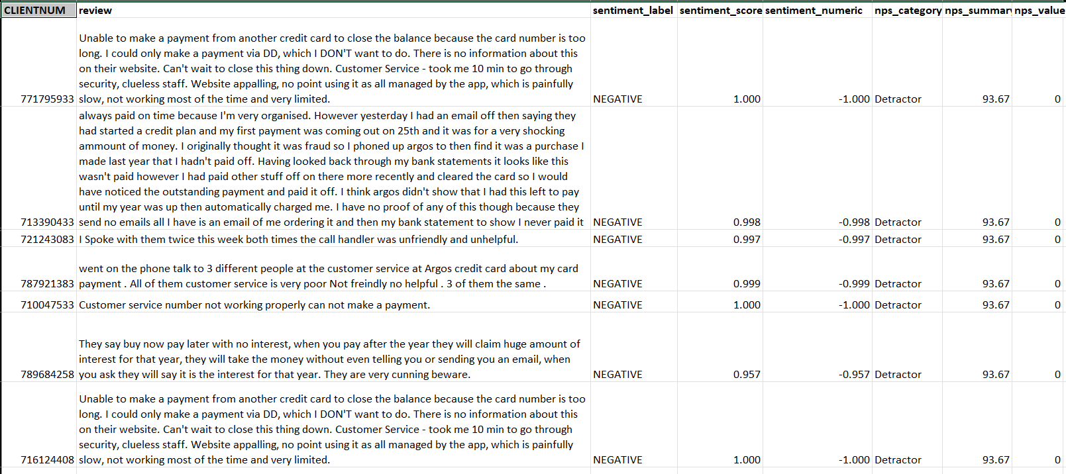
Sentiment and NPS Analysis for Voluntary Churn Customers
- By Hugging Face

Slide 20
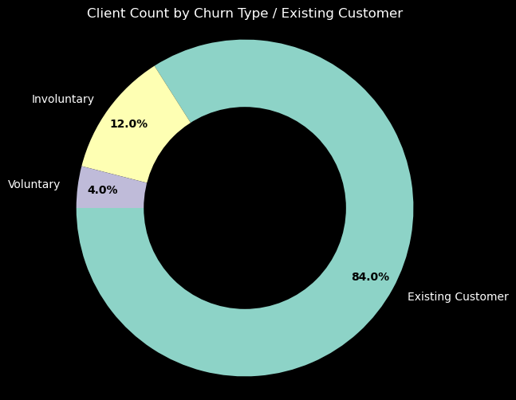
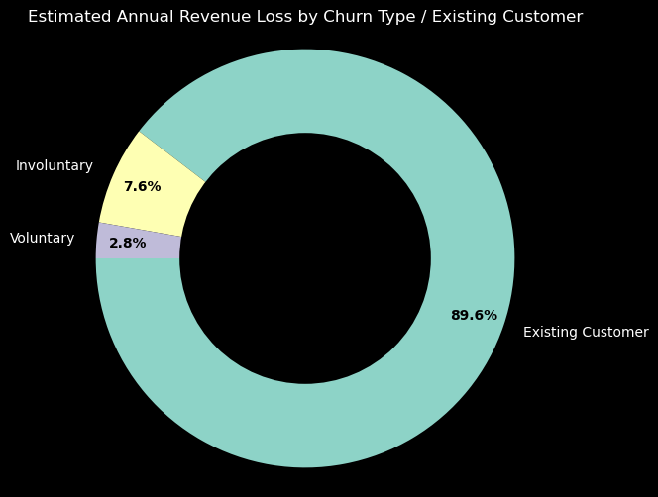
Client Counts by
Churn Type / Existing Customer
Estimated Annual Revenue by
Churn Type / Existing Customer

Slide 21
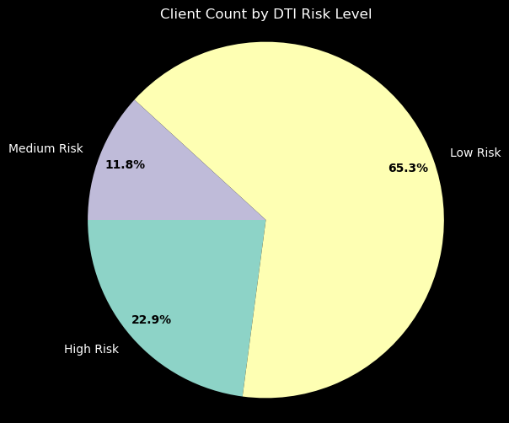
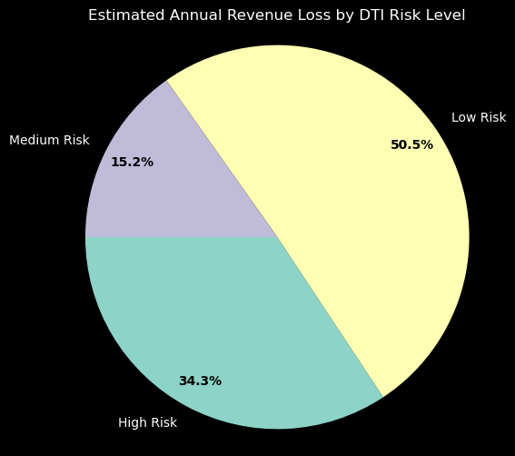
Client Counts by DTI Risk Level
Estimated Annual Revenue
By DTI Risk Level

Slide 22
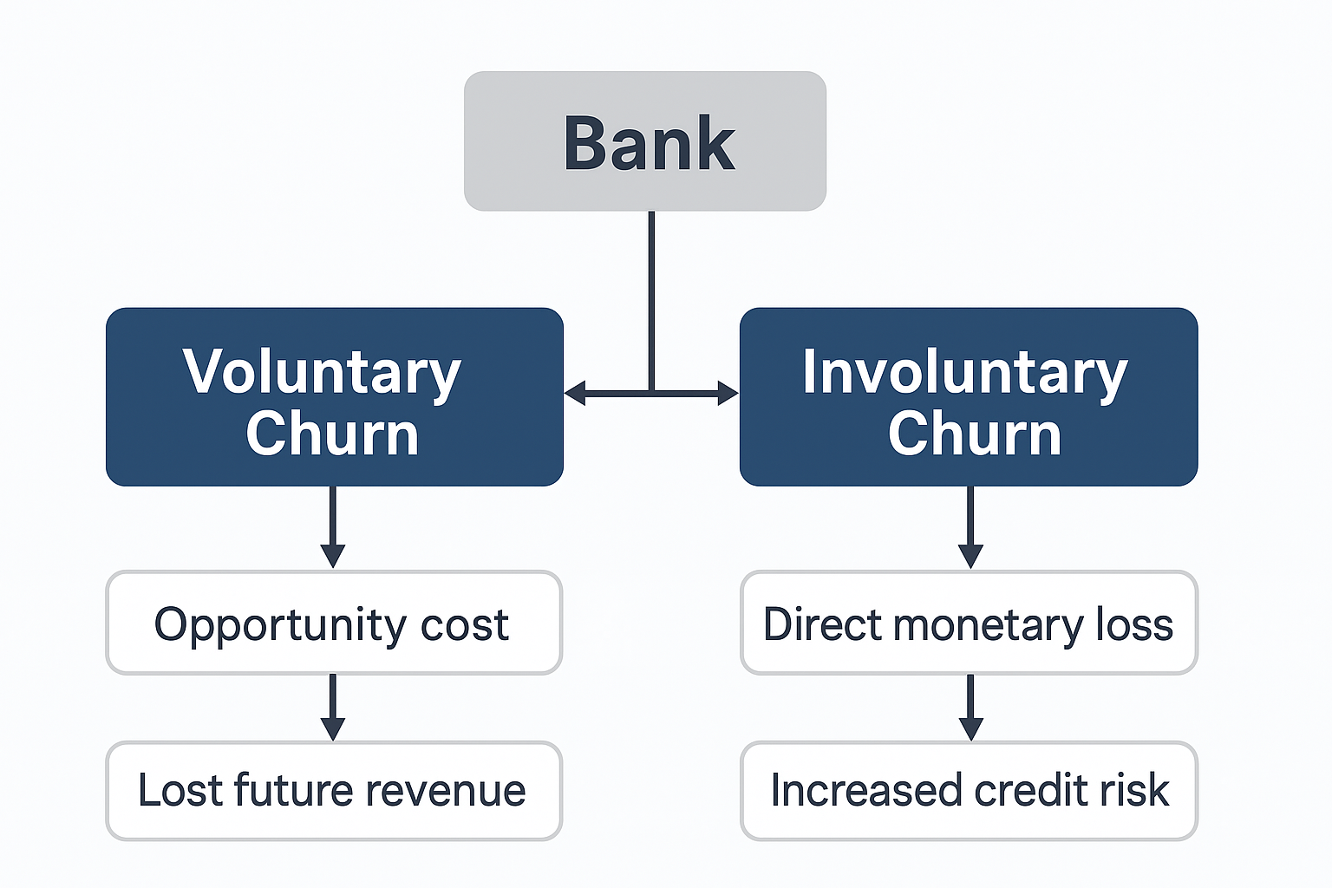

Slide 23
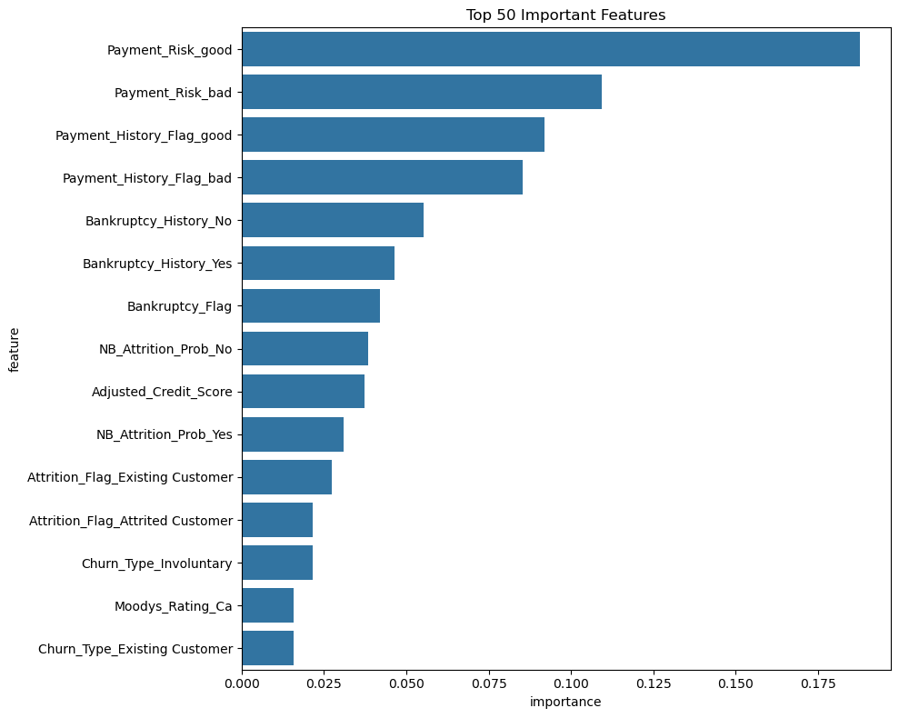
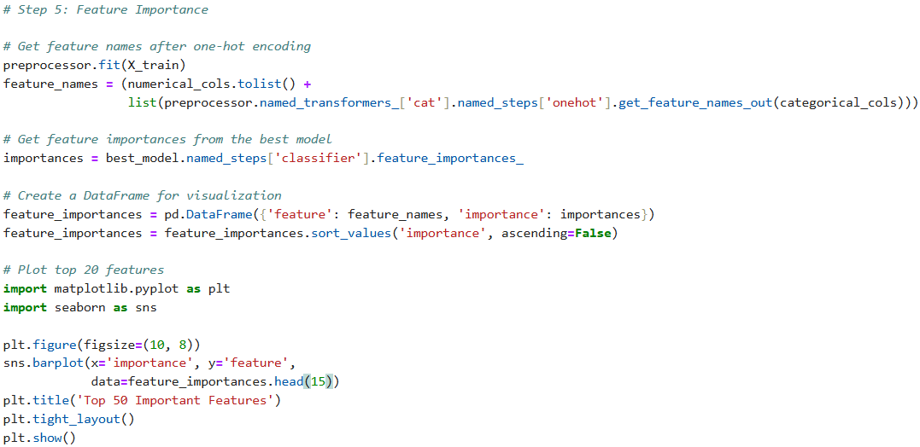
Machine Learning Models
(Logistic Regression, XGBoost)
Machine Learning Models
Top 15 Important Features

Slide 24
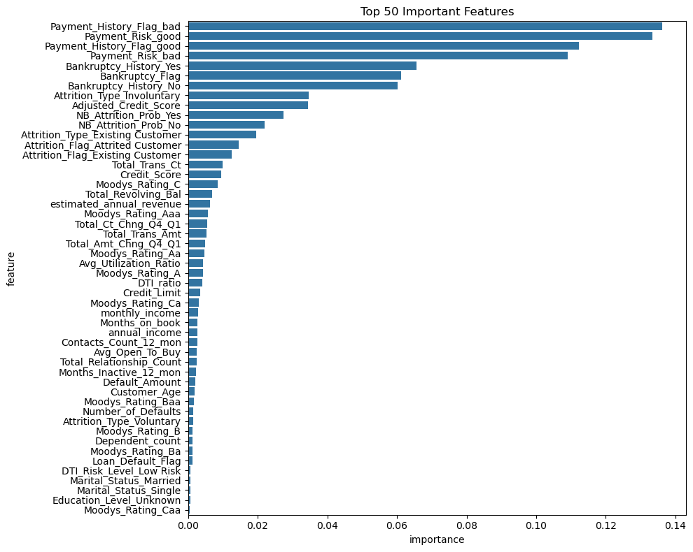
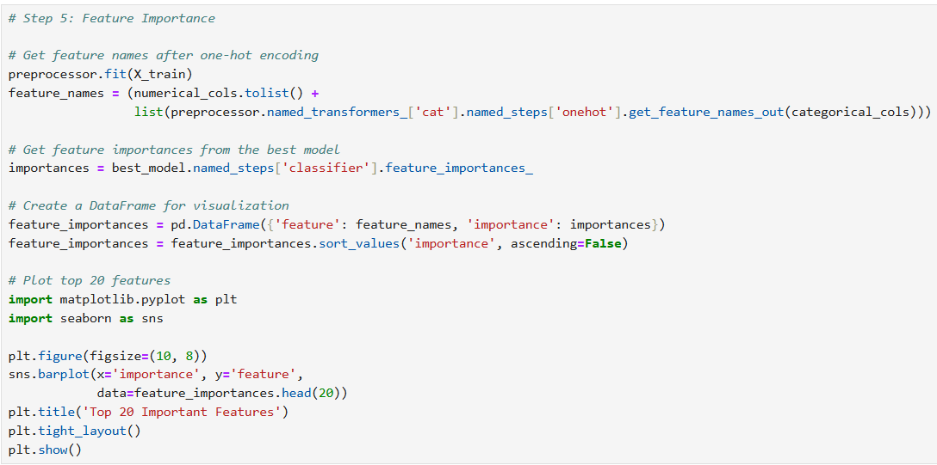
Machine Learning Models
Top 50 Important Features

Slide 25
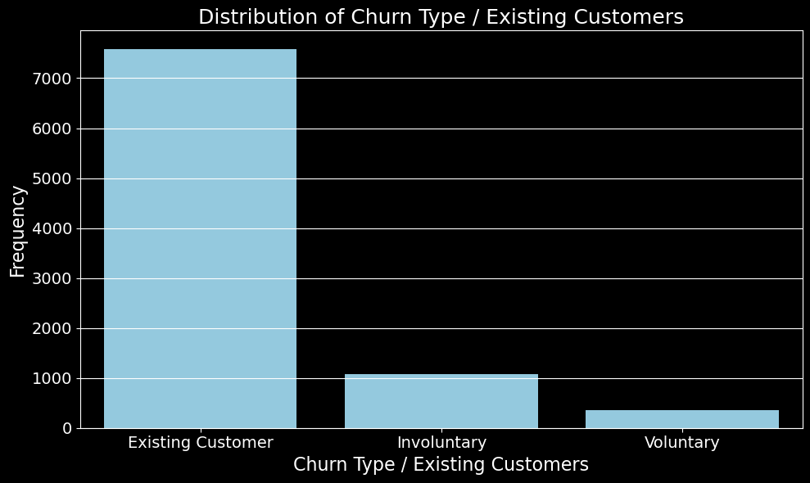
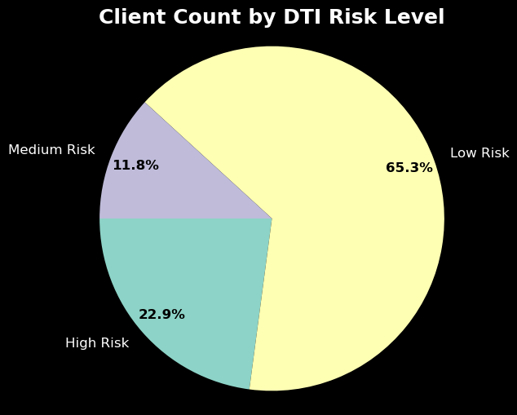
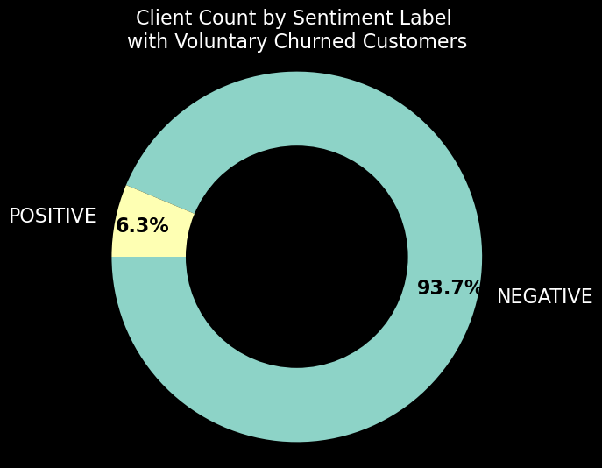

Executive Summary (1)

Slide 26


Executive Summary (2):
Machine Learning Modeling

Slide 27

Thank you all
Tricia
Turning data into meaningful stories with actionable insights
Data Analyst | Python • Power BI • SAS • SQL • Sentiment Analysis • NPS

